Slide 1
IoT Template

Slide 2
Agenda

Slide 3
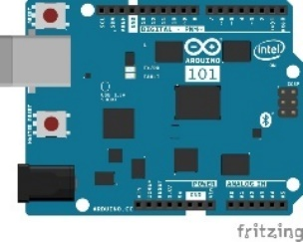
Lab Architecture
Development Workstation (Windows / OSx / Linux)
Resource Group <name>group
GET / POST
App Service Plan <name>plan
SEND / RECEIVE
SEND CLOUD-TO-DEVICE MESSAGES
Web App <name>web
IoT Hub <name>iot
Router w/ Internet Access
LOCAL RESOURCES
Power BI Embedded Workspace Collection <name>collection
AZURE RESOURCES
PowerBI Embedded Workspace
<name>workspace
Report Temperature Chart
SQL Db
<name>db
QUERY
RENDER
INSERT
Stream Analytics
<name>job
SEND / RECEIVE
QUERY
Intel NUC / IoT Gateway
QUERY
Arduino 101 & Grove Base Shield
Buzzer
SEND
RECEIVE
Function App
<name>functions
Event Hub <name>events
Function TempAlert
Temperature Sensor
Rotary Angle Sensor
SEND CLOUD-TO-DEVICE-MESSAGES
2 Row LCD Display

Slide 4
Lab Architecture
Resource Group <name>group
GET / POST
App Service Plan <name>plan
SEND / RECEIVE
SEND CLOUD-TO-DEVICE MESSAGES
Web App <name>web
IoT Hub <name>iot
Router w/ Internet Access
LOCAL RESOURCES
Power BI Embedded Workspace Collection <name>collection
AZURE RESOURCES
PowerBI Embedded Workspace
<name>workspace
Report Temperature Chart
SQL Db
<name>db
QUERY
RENDER
INSERT
Stream Analytics
<name>job
SEND / RECEIVE
QUERY
QUERY
Arduino 101 And Grove Base Shield
Buzzer
SEND
RECEIVE
Function App
<name>functions
Event Hub <name>events
Function TempAlert
Temperature Sensor
Rotary Angle Sensor
SEND CLOUD-TO-DEVICE-MESSAGES
2 Row LCD Display

Slide 5
IoT Logo

Slide 6
arduino

Slide 7
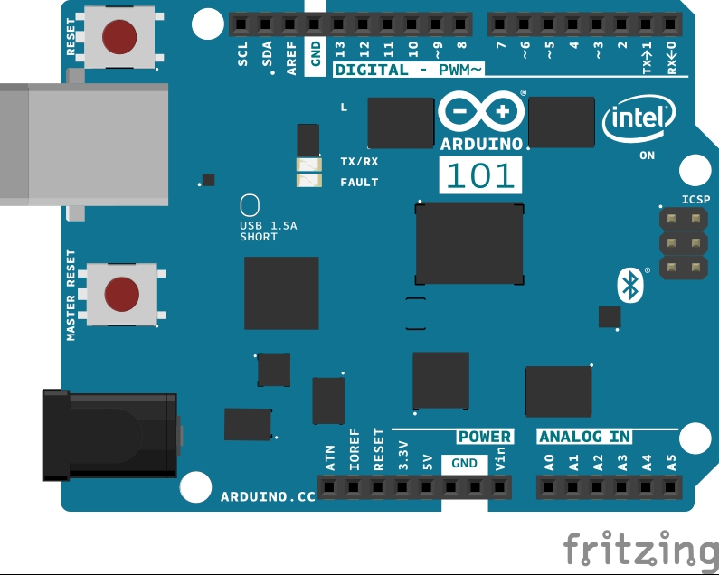
Arduino 101

Slide 8
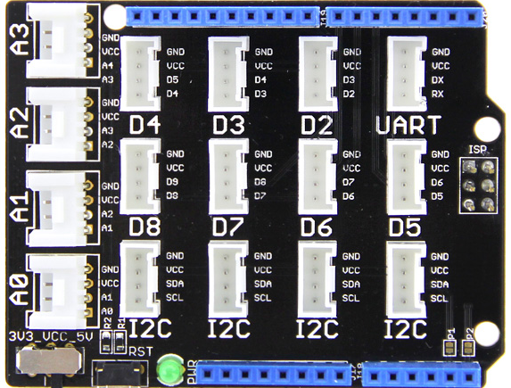
Grove Base Shield

Slide 9
Grove cable & SENSORS

Slide 10
Grove cable & SENSORS

Slide 11
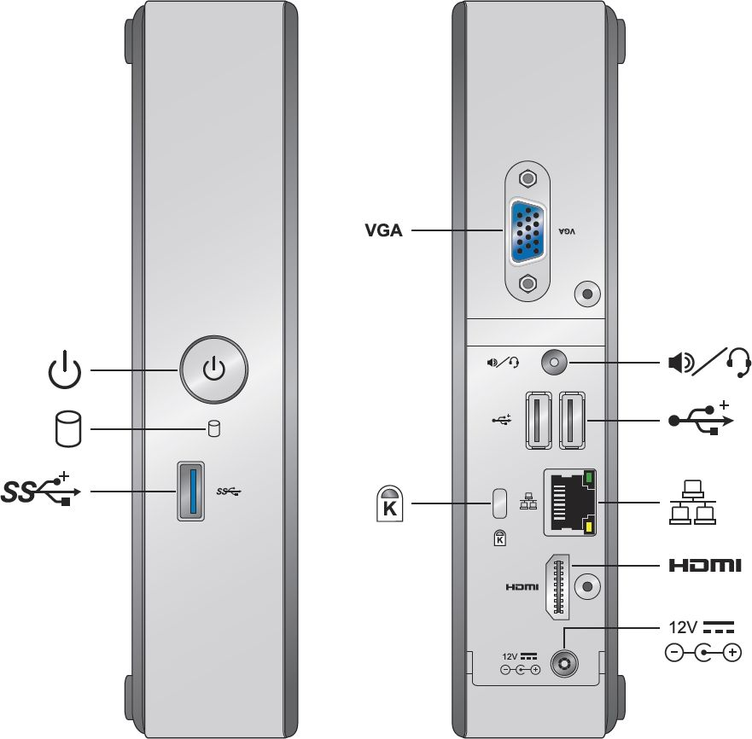
INTEL NUC DE3815TYKE

Slide 12
GALILEO BOARD

Slide 13
RASPBERRY PI

Slide 14
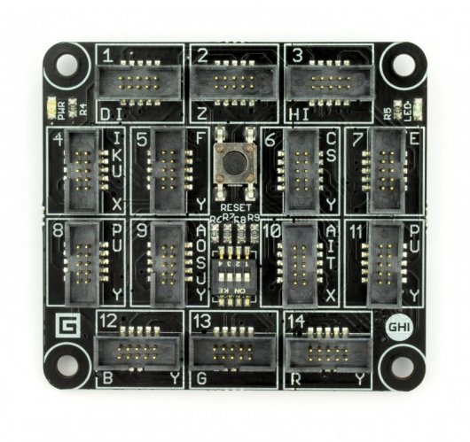
FEZ SPIDER MAIN BOARD

Slide 15
Sparkfun weather shield

Slide 16
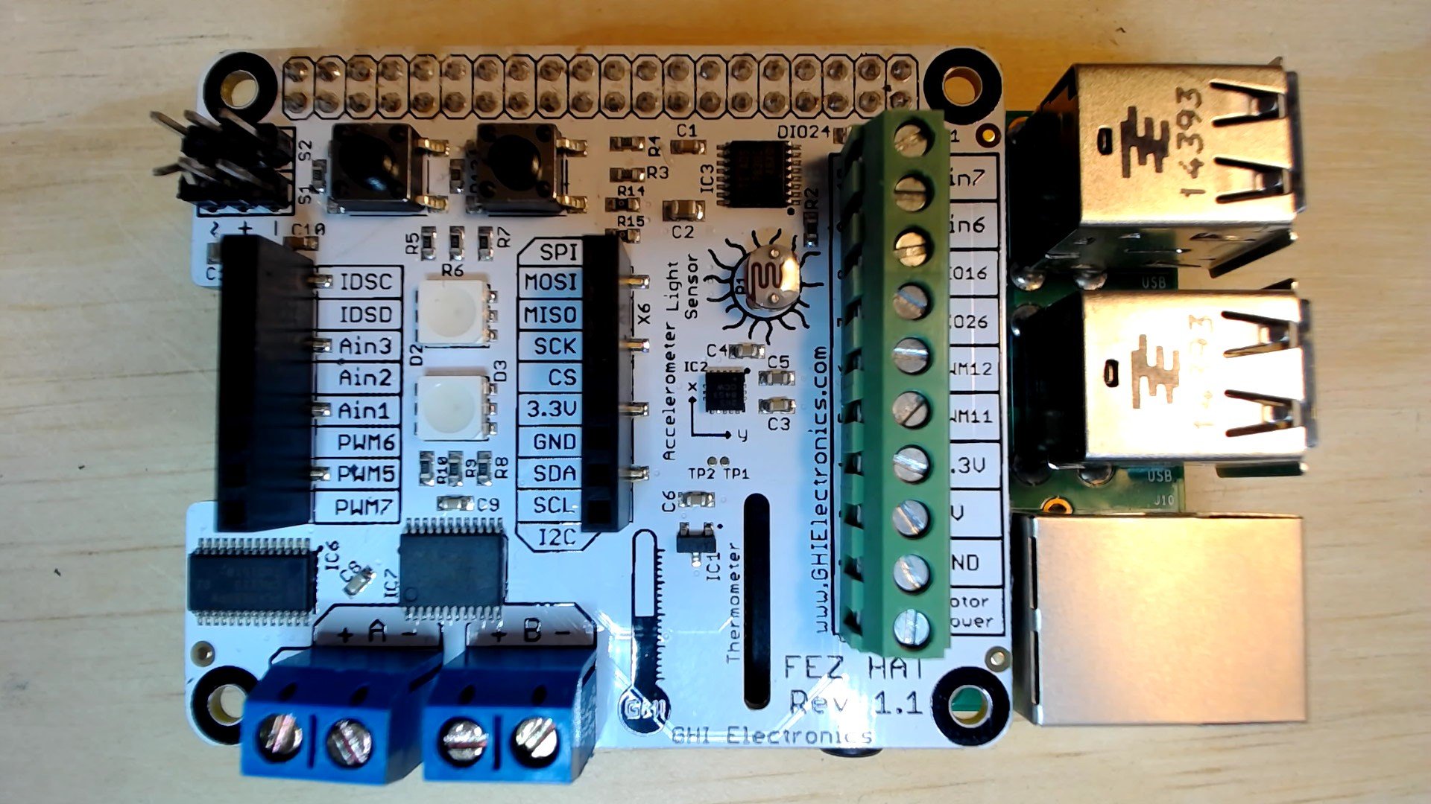
FEZ HAT

Slide 17
Connect the dots azure icons
Event Hubs
Stream Analytics
Storage
(
Azure
Microsoft Azure
Web App
Service Bus
)
Storage blob
Storage table
SQL database
HDInsight
Machine
(
Learning
GitHub code
Git repository
IoT Hubs
generic
)

Slide 18
LEDs

Slide 19
Resistors
220Ω
1st Digit
2nd Digit
Multiplier
Tolerance
Color | Name | 1st Digit | 2nd Digit | Multiplier | Tolerance
 | Black | 0 | 0 | X1
 | Brown | 1 | 1 | X10 | 1%
 | Red | 2 | 2 | X100
 | Orange | 3 | 3 | X1,000
 | Yellow | 4 | 4 | X10,000
 | Green | 5 | 5 | X100,000
 | Blue | 6 | 6 | X1,000,000
 | Violet | 7 | 7
 | Grey | 8 | 8
 | White | 9 | 9
 | Gold |  |  | X0.1 | 5%
 | Silver |  |  | X0.01 | 10%
330Ω
10KΩ

Slide 20
cables

Slide 21
More cables and adapters

Slide 22

LEDs
Anode (+)
Cathode (-)
Flat Edge
Small Post
Big Post
Long Leg
Short Leg
Vcc (+)
GND

Slide 23
LEDs

Slide 24
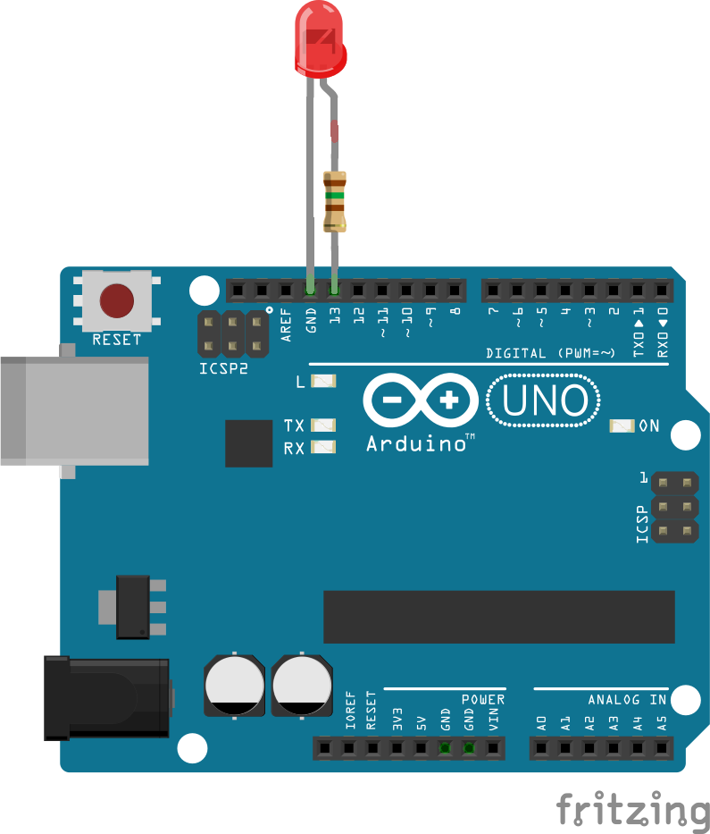
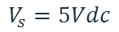
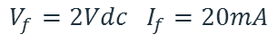
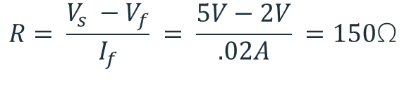
Current limiting resistors
Providing more current than an LED is rated for can destroy the LED. To prevent that, you should use a “Current Limiting” resistor.
To calculate the value of the resistor you need to know the supply voltage (Usually 5V on the Arduino Uno), and the LEDs rated Forward Voltage (the voltage drop across the LED) and Forward Current (the maximum current the LED can handle).
$$V_{f}=2Vdc I_{f}=20mA$$
$$Resistor Value (R)= \frac{Supply Voltage \left(V_{s}\right)−LED Forward Voltage (V_{f}) }{LED Forward Current (I_{f})}$$
$$V_{s}=5Vdc$$
$$R= \frac{V_{s} −V_{f}}{I_{f}} = \frac{5V−2V}{.02A} =150\text{Ω}$$
The Arduino Uno has a built in current limiting resistor on Pin 13. If you use Pin 13 to power your LED you can use it without a separate resistor.

Slide 25
Resistors
220Ω
1st Digit
2nd Digit
Multiplier
Tolerance
Color | Name | 1st Digit | 2nd Digit | Multiplier | Tolerance
 | Black | 0 | 0 | X1
 | Brown | 1 | 1 | X10 | 1%
 | Red | 2 | 2 | X100
 | Orange | 3 | 3 | X1,000
 | Yellow | 4 | 4 | X10,000
 | Green | 5 | 5 | X100,000
 | Blue | 6 | 6 | X1,000,000
 | Violet | 7 | 7
 | Grey | 8 | 8
 | White | 9 | 9
 | Gold |  |  | X0.1 | 5%
 | Silver |  |  | X0.01 | 10%
330Ω
10KΩ

Slide 26
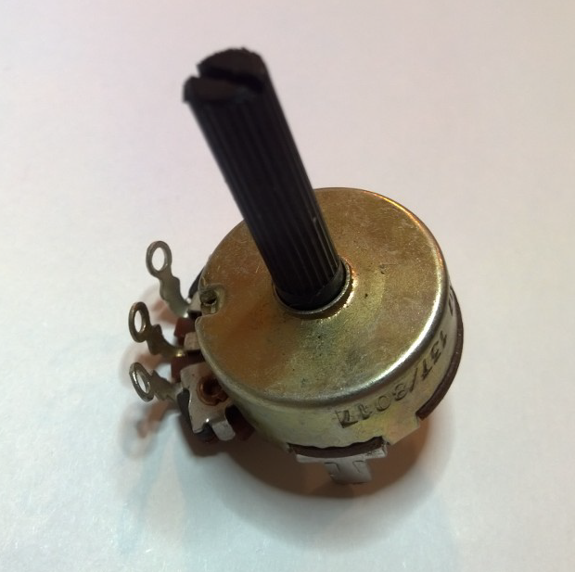
Potentiometer – variable resistor

Slide 27
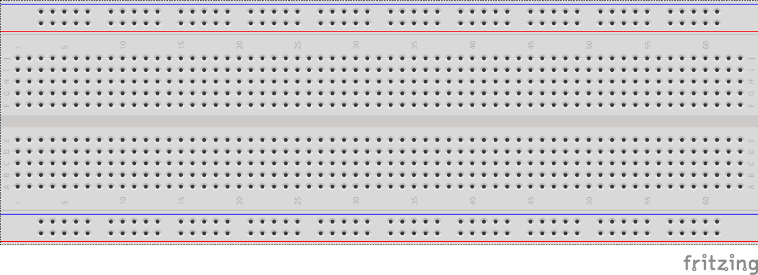
breadboards
Breadboards offer a great way to prototype circuits. The provide a number of “buses” for connecting both power and components.
Power buses run the entire horizontal length
Component buses give you easy ways to connect pins together

Slide 30
Micro SD Cards
Font: Segoe UI Semibold

